Slide 1

xxxxxxxxxx xxxxxxxxxx
xxxxxxxxxxxx
UCB Data Analytics Bootcamp
Project 3 -Team 5
Accessibility of EV chargers across the US for ease of travel
Notes:
Teams will also create a 10-minute presentation that lays out your theme, approach, techniques, and final visualizations.
The presentation consists of four components:
1. Slide deck
4. Recording, or live demo, of interactive visualizations
5. Insights and/or deductions
5. Group presentations
Specific Requirements: Presentation
1. Each team will have 10 minutes to present. Each member needs to present at least one slide
2. Your presentation must have a clear objective and purpose.
3. Your presentation should use relevant and accurate data.
4. Your presentation should employ effective visual design.
5. Use clear and concise communication.
6. Your presentation must tell a story.
7. Your presentation should include insightful analysis and interpretation.
8. Your presentation should be well-organized and professional in tone and delivery.

Slide 2
Accessibility of EV chargers across the US for ease of travel
Group Members:
David Kim
V Iosif
RoseMary Rios
Jean Vicencio

Slide 3
Why buy an EV?
One of the reasons why people refuse to buy EVs
money saver
cut emissions
better driving experience
cuts oil
convenient
Notes:
source: https://www.ucsusa.org/resources/top-five-reasons-choose-electric-car?utm_source=googlegrants&utm_medium=search&utm_campaign=CV&gad_source=1&gclid=Cj0KCQjwrKu2BhDkARIsAD7GBovqYGi0e4Af08Fh-nVmfyGaWenS8Ta_1reB2zTCmQ9dLdzb5X0glnoaAvHQEALw_wcB
Youtube video:
https://www.youtube.com/watch?v=Pt3hkv0ELvw

Slide 4
Goal
This analysis seeks to showcase the availability of Electric Vehicle chargers across US and their unique charge speed rate along with the correlation with EV registration to:
enhance consumer confidence in the accessibility of EV charging infrastructure
help potential and current EV owners better plan their travels
encourage broader adoption of EVs
Notes:
In support of reducing the US carbon footprint via use of EVs, this analysis seeks to showcase the availability of EV chargers by state and their unique charge speed rate. The goal of compiling this data is to enhance consumer confidence in the accessibility of EV charging infrastructure. This will help potential and current EV owners better plan their travels
and encourage broader adoption of EVs.
Title: "Powering Up: Ensuring the Future of Electric Vehicles Through Strategic Charging Infrastructure"
In a world where electric vehicles (EVs) are on the rise, a critical concern emerges: will the current infrastructure support this surge in EV sales? The availability of EV charging stations plays a pivotal role in the success of electric mobility. If the infrastructure fails to keep pace with the increasing adoption of EVs, we face the risk of stunted sales growth or a flood of resale EV vehicles.
To address this challenge, our project delves into the intricate relationship between EV charging station availability and the expanding market for electric vehicles. By analyzing the distribution and density of EV chargers across the United States, we aim to uncover potential gaps that could hinder the seamless transition to electric transportation.
Our key objectives include:
Mapping the Landscape: We will showcase the density and distribution of EV chargers in the US, providing a visual representation of the current charging infrastructure.
Aligning Supply and Demand: By correlating EV registration data with charger availability, we seek to identify any discrepancies that may impact the growth of EV sales.
Speed Matters: Categorizing charging stations based on the type of chargers available will offer insights into the availability of different charging speeds. Understanding this variation is crucial for meeting the diverse needs of EV drivers.
Through this comprehensive analysis, we aim to pave the way for a sustainable future of electric vehicles, ensuring that the charging infrastructure evolves in harmony with the increasing demand for clean and efficient transportation solutions.

Slide 5
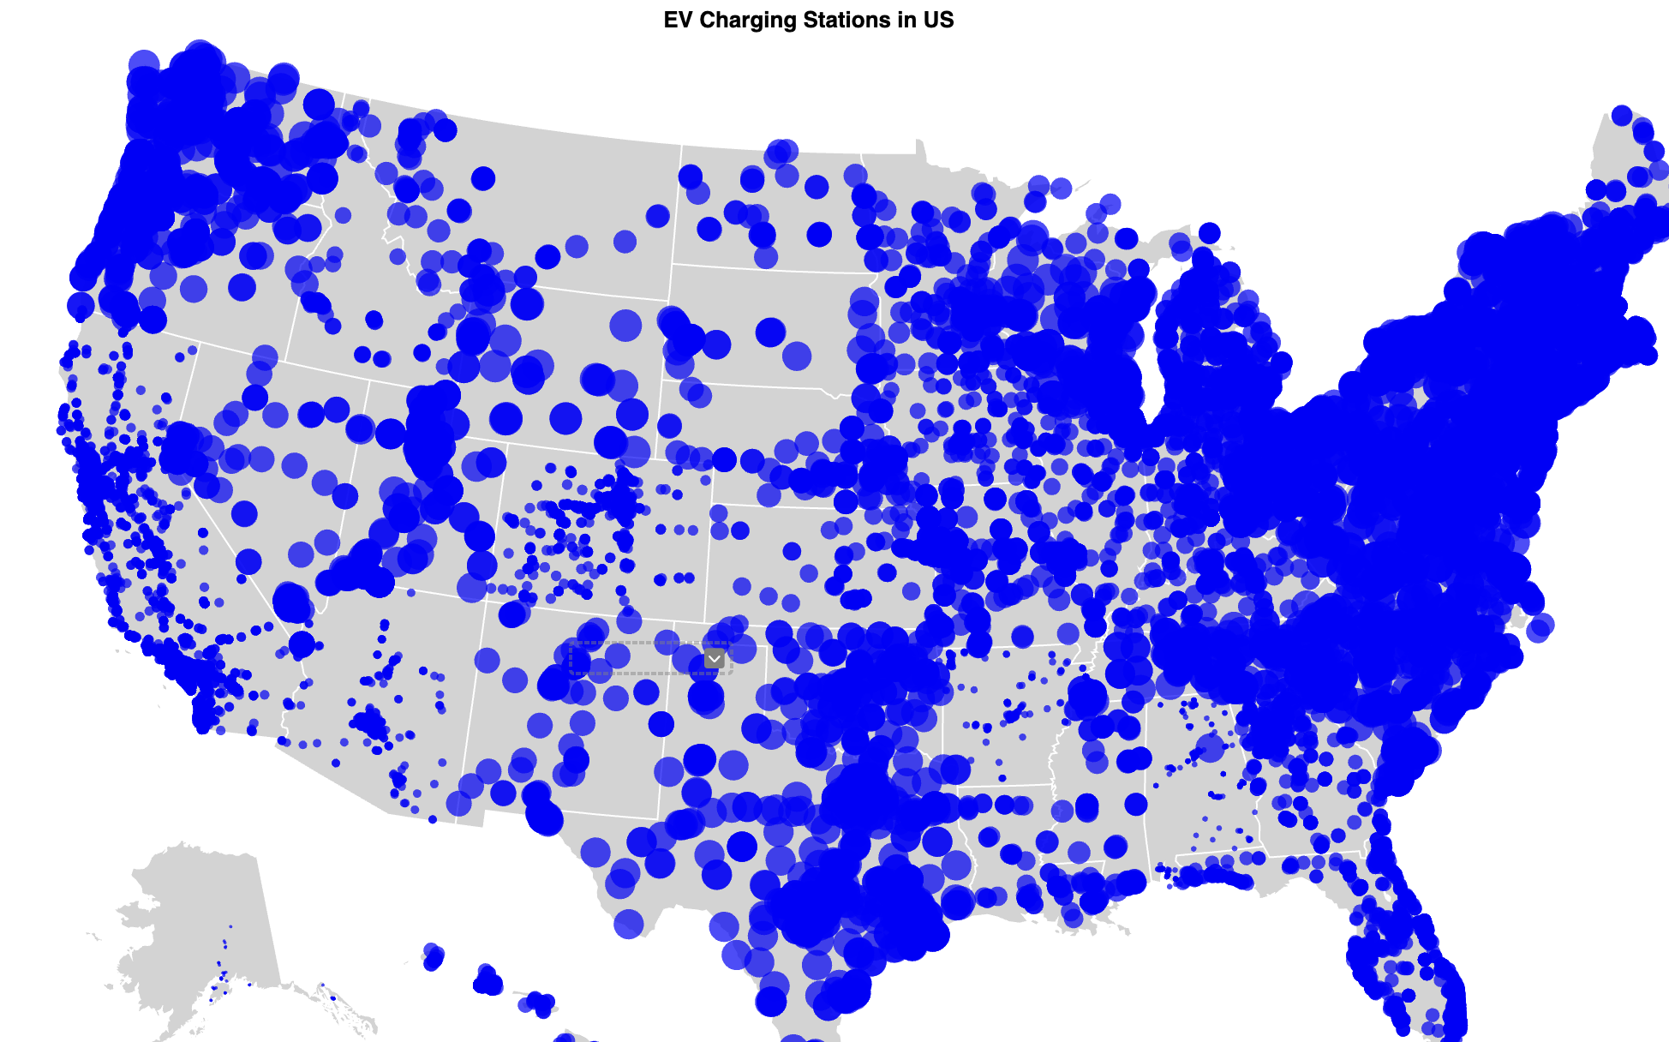
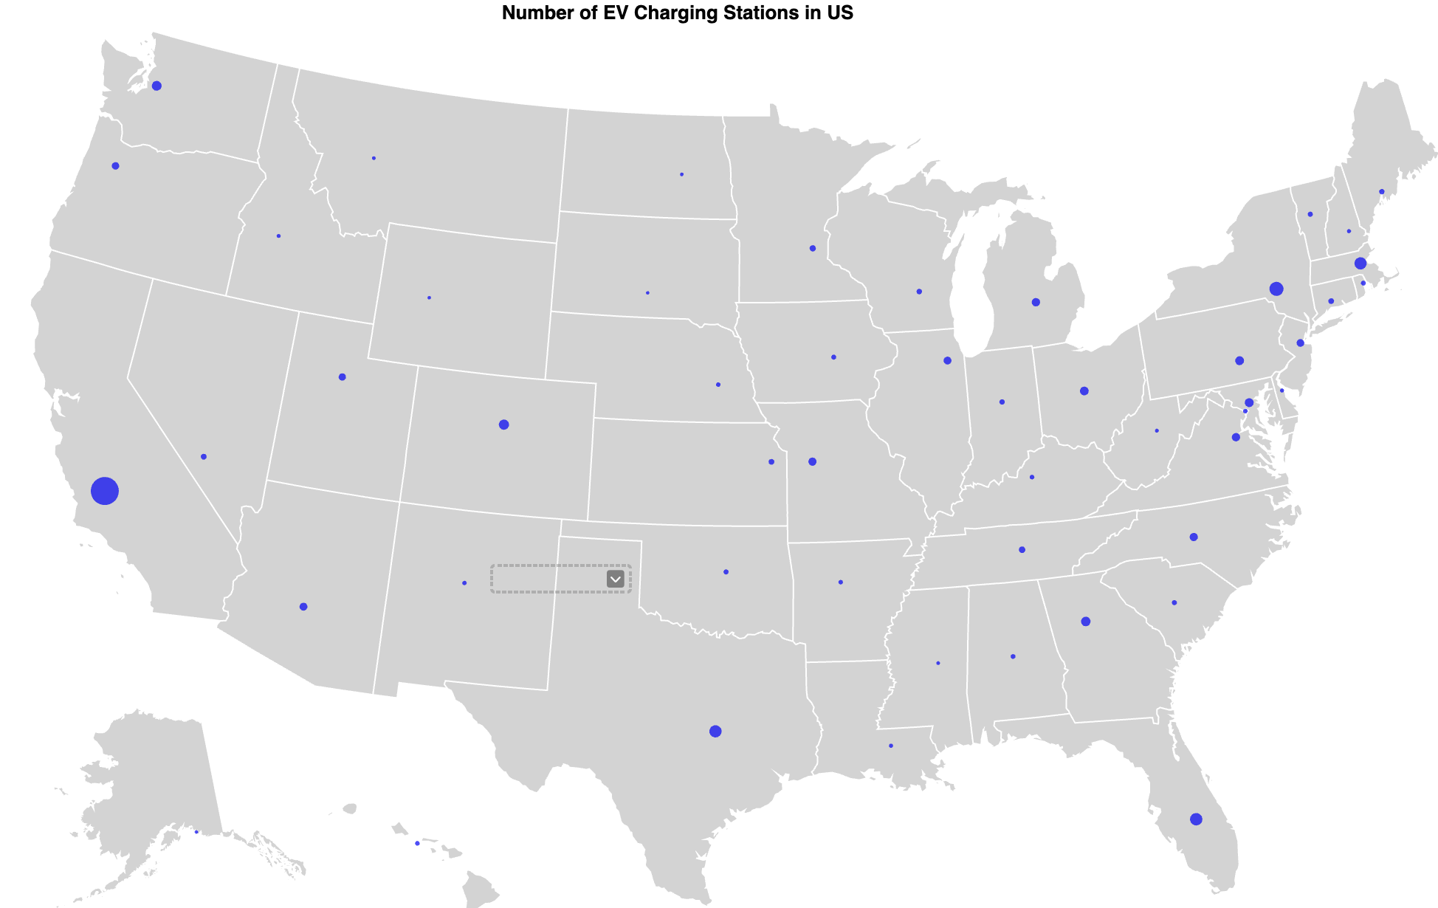
EV Charger Density & Distribution
Notes:
California has many electric vehicle (EV) charging stations because of its climate change agenda and the state's goal of transitioning to a low-carbon future. California has a mandate that requires 68% of new cars sold in 2030 to be zero emissions, and 100% in 2035.

Slide 6
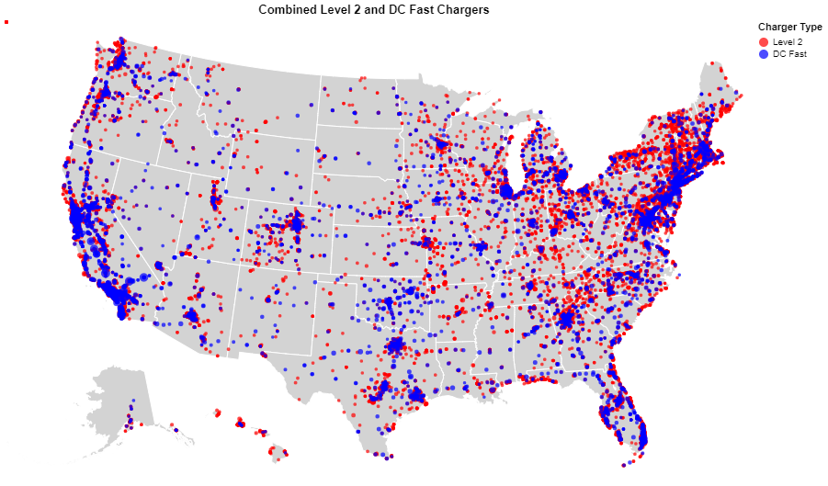
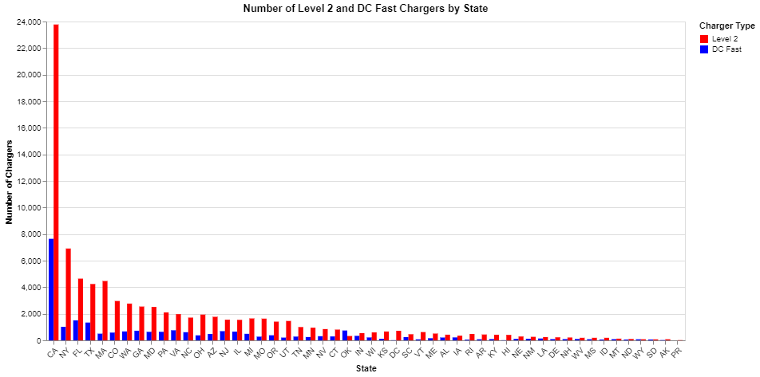
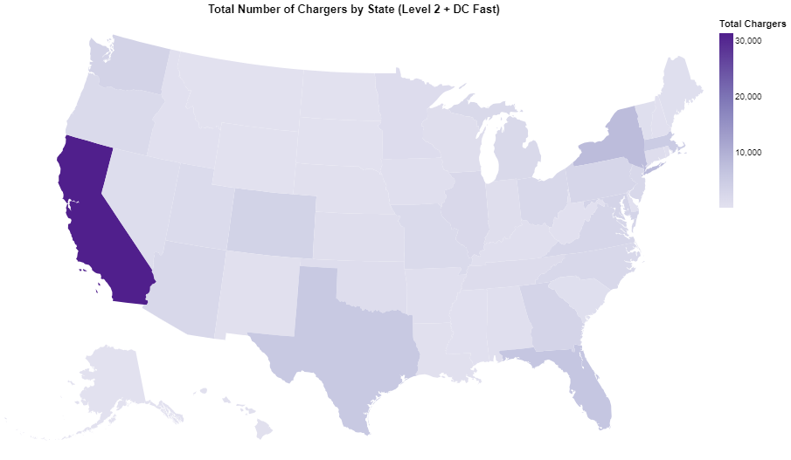
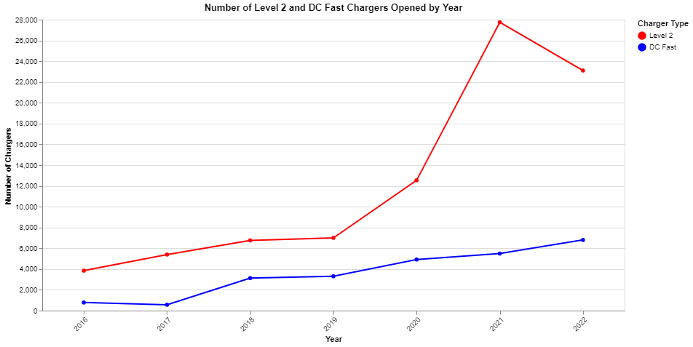
EV Charger Speed Availability

Slide 7
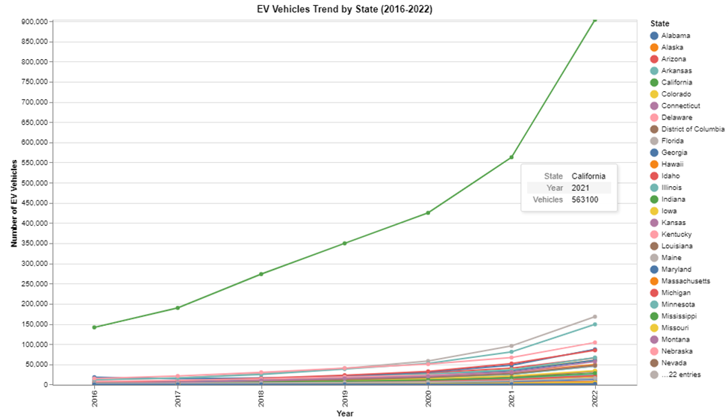
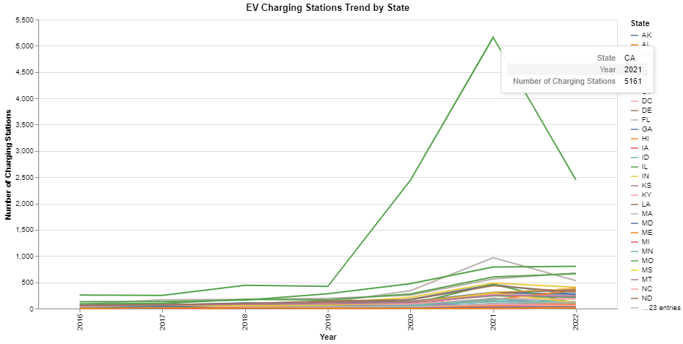
EV Charging Infrastructure & EV Registration
Notes:
https://www.eia.gov/todayinenergy/detail.php?id=61082

Slide 8
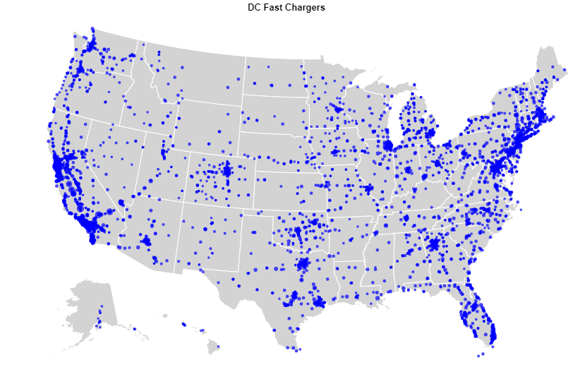
Best Travel Route for EV from New York to L.A.

Slide 9
THANK YOU!

